Slide 1
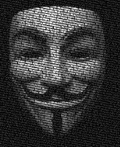
Department of Public Works
Cyber Security – The Changing Landscape
Cyber Security Landscape
Threat Actors
Motives
Tools & Techniques
Information Security Evolution
Defending Against Today’s Threats
Khaled Tawfik
ktawfik@dpw.lacounty.gov
Erick Weber
eweber@dpw.lacounty.gov

Slide 2
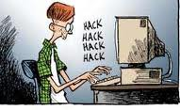
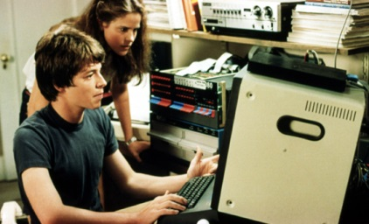
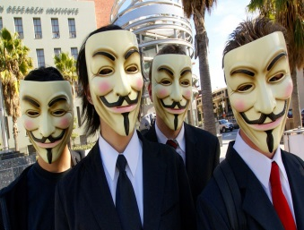
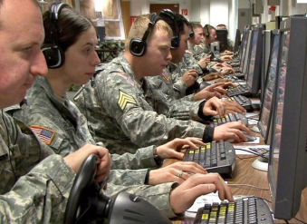
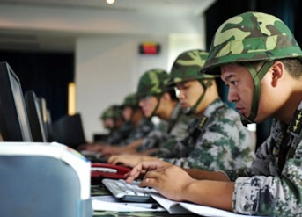
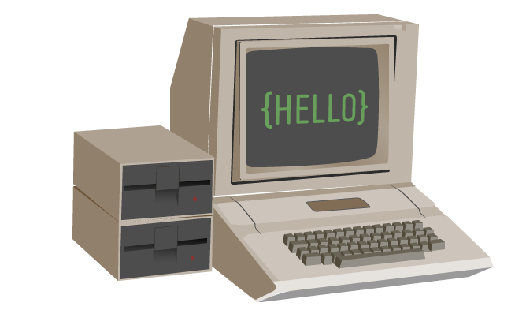
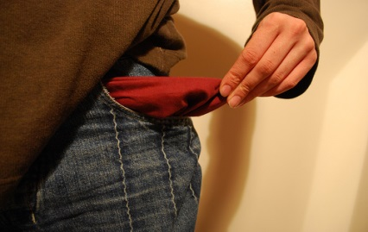
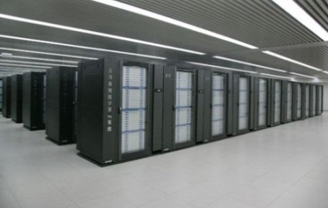
Changing Landscape
THEN | NOW
So what has changed over the past 30 years?

Slide 3
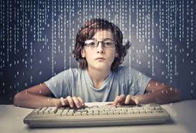
Threat Actors
Script Kiddies
Insiders
Competitors
Hacktivists
Organized Crime
State Sponsors

Slide 4
Threat Actors
Script Kiddies
Insiders
Competitors
Hacktivists
Organized Crime
State Sponsors

Slide 5
Threat Actors
Script Kiddies
Insiders
Competitors
Hacktivists
Organized Crime
State Sponsors

Slide 6
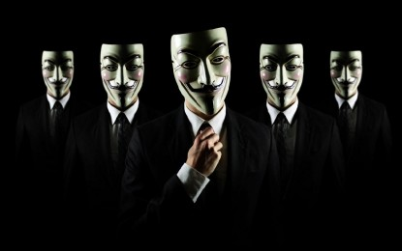
Threat Actors
Script Kiddies
Insiders
Competitors
Hacktivists
Organized Crime
State Sponsors

Slide 7
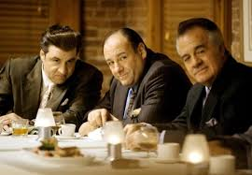
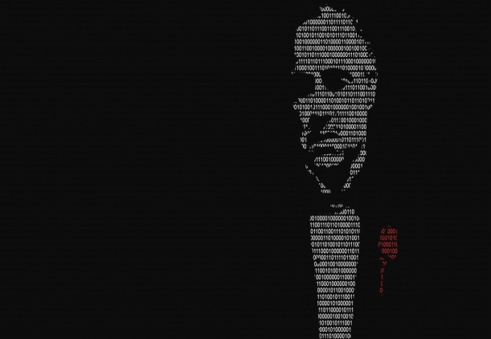
Threat Actors
Script Kiddies
Insiders
Competitors
Hacktivists
Organized Crime
State Sponsors

Slide 8
Threat Actors
Script Kiddies
Insiders
Competitors
Hacktivists
Organized Crime
State Sponsors

Slide 9
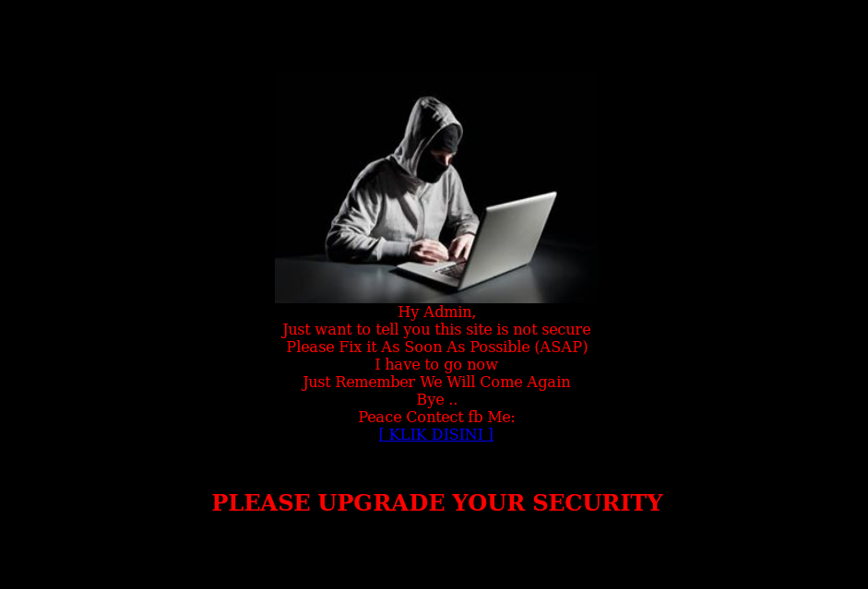
Motives
Prestige
Financial / Competitive
Political
Ideological
Military
Who are the Actors?
Script Kiddies
Hacktivists

Slide 10
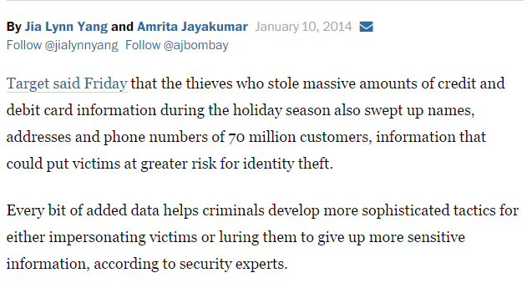
Motives
Prestige
Financial / Competitive
Political
Ideological
Military
Who are the Actors?
Insiders
Competitors
Organized Crime

Slide 11
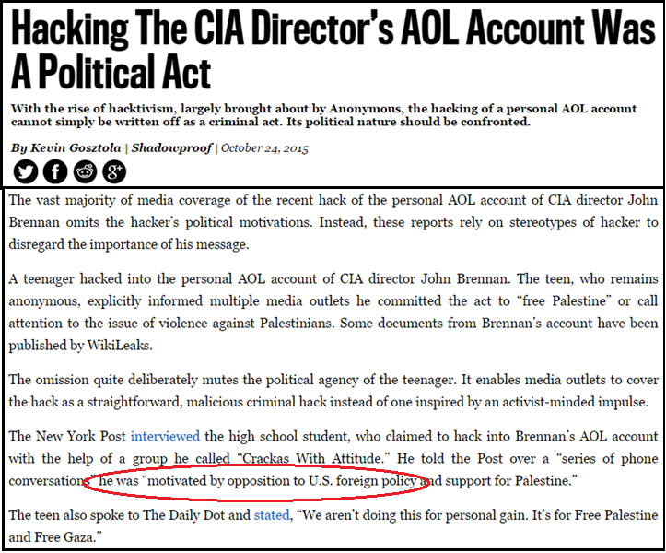
Motives
Prestige
Financial / Competitive
Political
Ideological
Military
Who are the Actors?
Hacktivists
State Sponsors

Slide 12
Motives
Prestige
Financial / Competitive
Political
Ideological
Military
Who are the Actors?
Hacktivists
Insiders

Slide 13
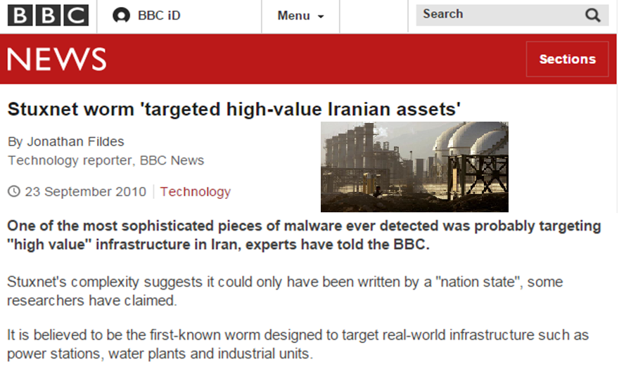
Motives
Prestige
Financial / Competitive
Political
Ideological
Military
Who are the Actors?
State Sponsors

Slide 14
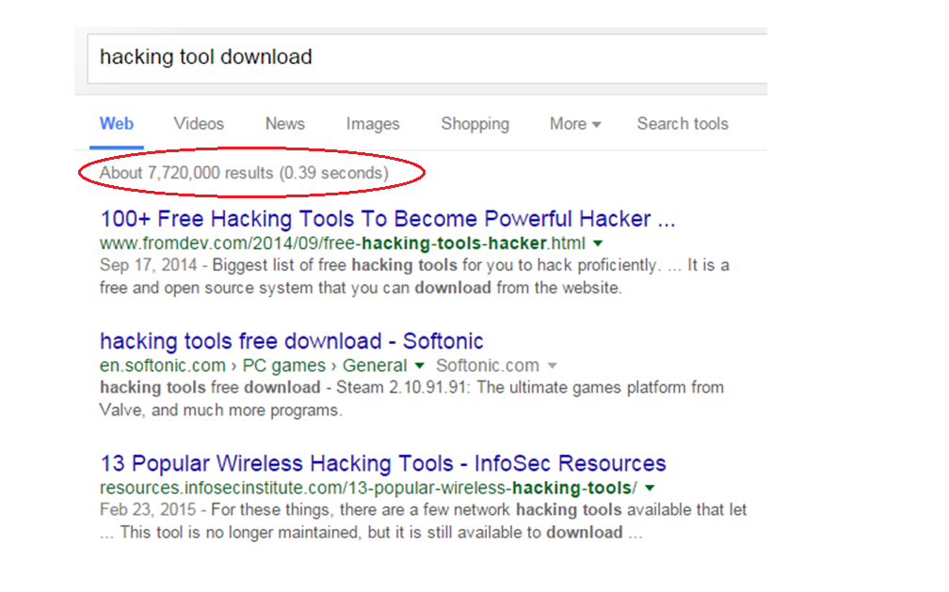
Tools

Slide 15
Tools
Network Scanners
Nmap
Nessus
Password Crackers
THC Hydra
John the Ripper
Linux Distros
Kali
BackTrack
App/DB Scanners
ZAP
W3af
WebReaver
Arachni
SQL Map
Network Sniffers
Wireshark
Aircrack
Browser Proxies
Burp
Fiddler
Exploit Frameworks
Metasploit
BeEF
Cain & Abel

Slide 16
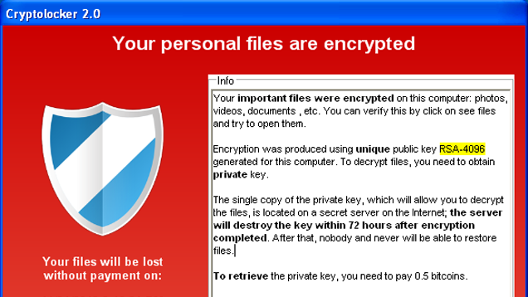
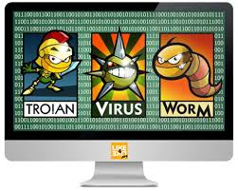
Tools
Malware
Virus – Requires user interaction to spread
Worms – Does not require user interaction
Trojans – Disguised as legit program
Spyware – Tracks activities / Steals Info
Rootkits – Hide from security software
Exploit Kits – Toolkit to automate exploitation
Ransomware – Encrypts files / holds for ransom

Slide 17
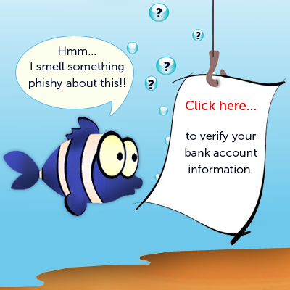
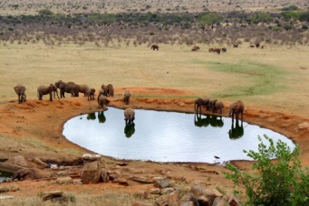
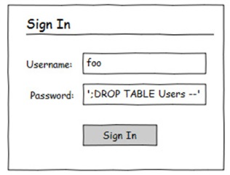
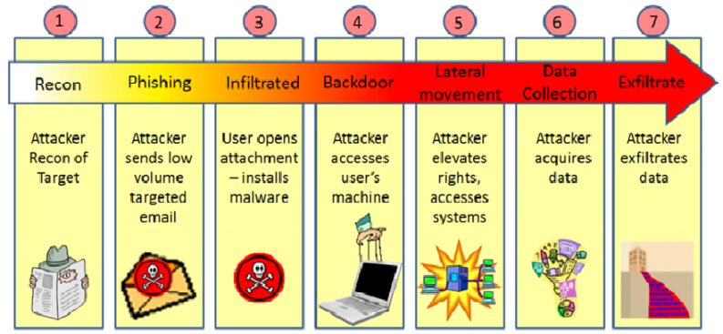
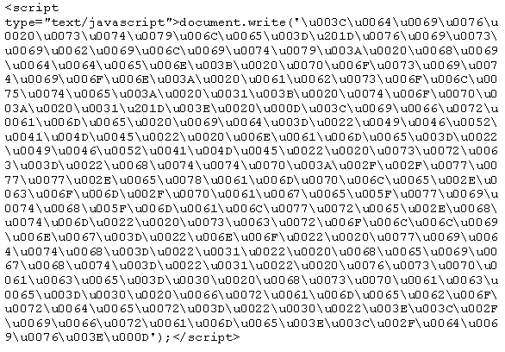
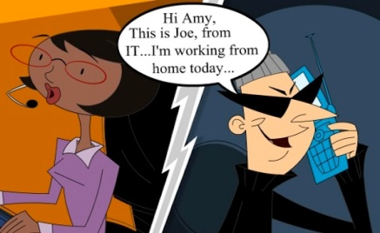
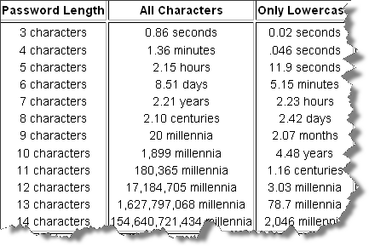
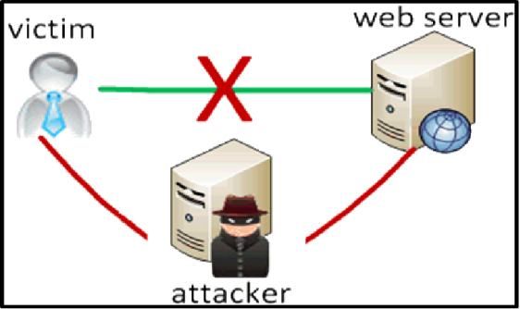
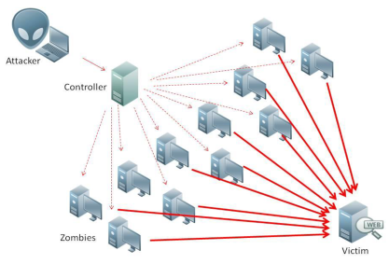
Techniques
Attack Techniques
Social Engineering
Password (brute force/cracking/default)
Traffic Sniffing / Man-in-the-Middle
Distributed Denial of Service (DDoS)
Web App (SQL Injection, Cross-Site Scripting)
Watering Holes
Phishing / Spear Phishing
Advanced Persistent Threats (APTs)
Evasion/Obfuscation

Slide 18
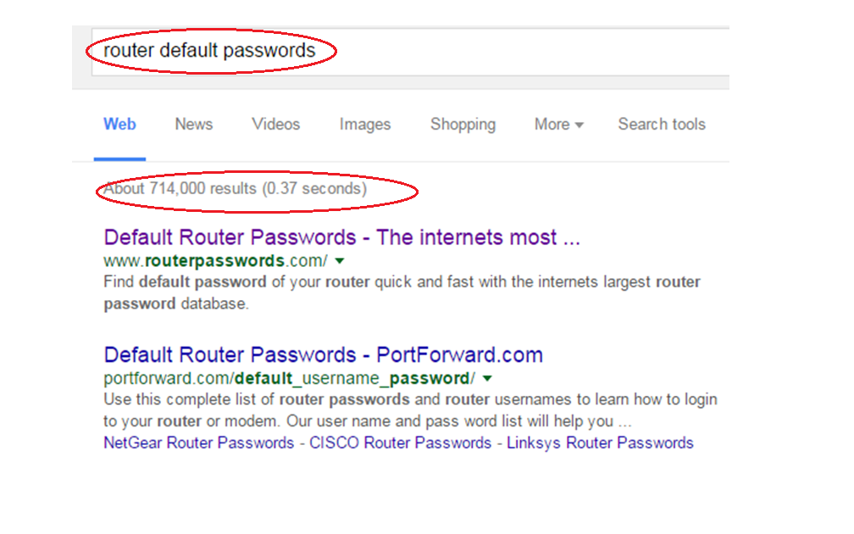
Default Password Attack

Slide 19
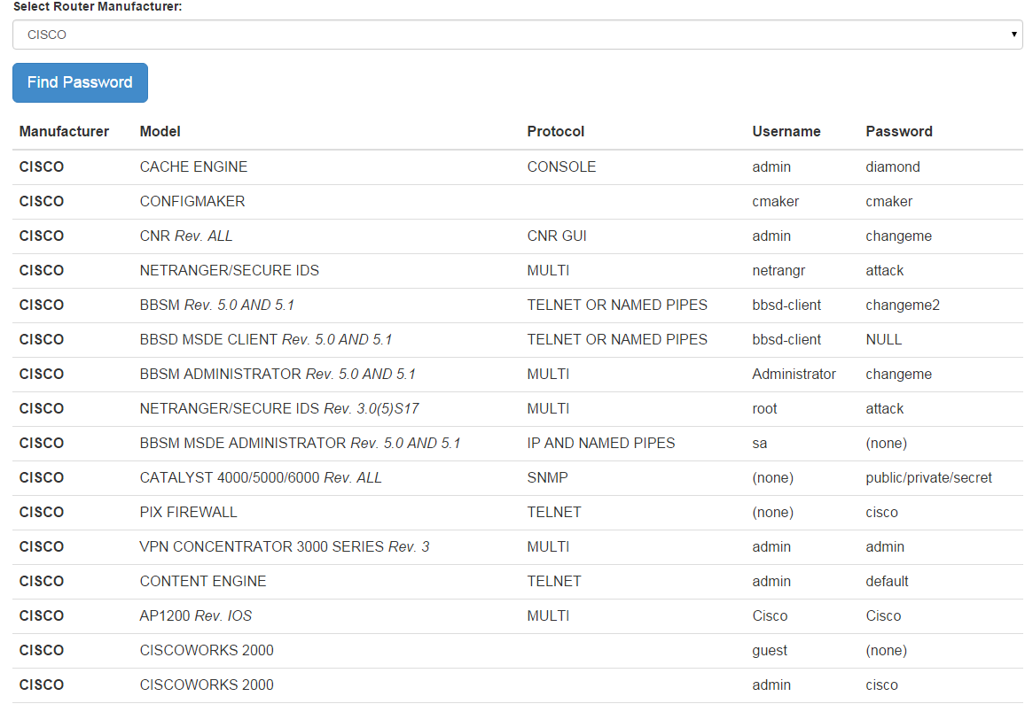

Slide 20
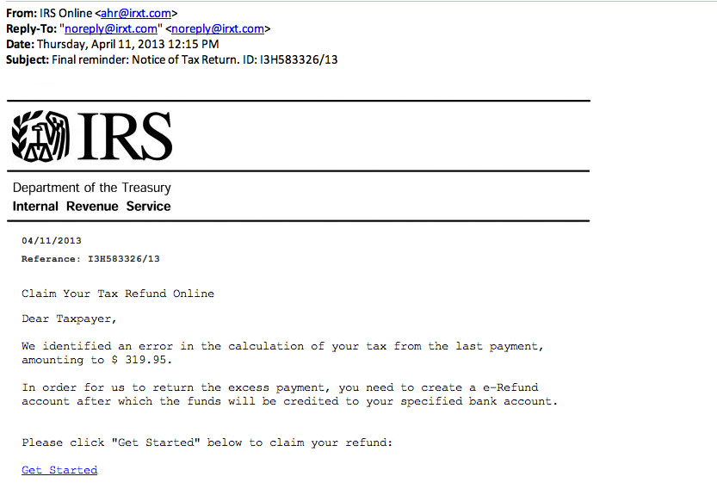
Phishing Attack

Slide 21
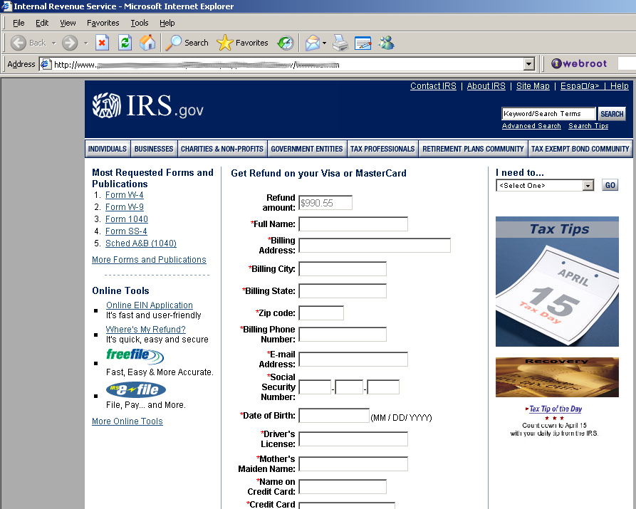

Slide 22
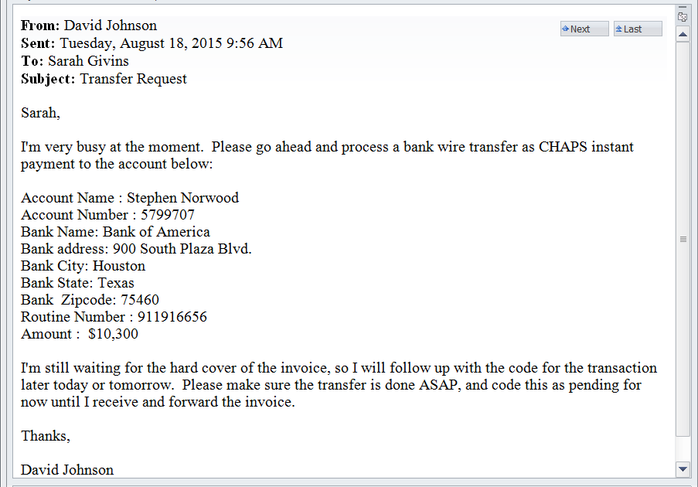
Spear Phishing Attack

Slide 23
Security Function Evolution
Board of Supervisors
Security Awareness Officer
App Security Engineer
IT Forensics Engineer
Penetration Tester
Chief Info Security Officer
IT Auditor
Network Security Engineer
IT Administrator

Slide 24
Defending Against Today’s Threats
Program
Governance
Risk Assessment
Security Controls
Vulnerability & Patch Mgmt.
SDLC
Awareness & Training
Monitoring & Response
DRP / BCP

Slide 25
How to Protect Yourself
Apply security patches (O/S and apps)
Install & update Anti-Virus software
Web Site Protection (OpenDNS / McAfee Site Advisor)
Use two-factor authentication for logins
Don’t use the same passwords for all sites
Don’t click on web links or attachments in emails

Slide 26
Department of Public Works
Khaled Tawfik
ktawfik@dpw.lacounty.gov
Erick Weber
eweber@dpw.lacounty.gov
www.dpw.lacounty.gov

